Slide 1
Infrastructure for Data Science and Big Data
Big Data

Slide 2

Welcome
When people surf the web, access social networks, make purchases online, carry out financial transactions or operations in their online banking, or when transactions are carried out between suppliers and manufacturers, etc., enormous amounts of information are generated; and which are collected and stored.
This information can be used by organizations to achieve competitive advantages in the markets and improve market share and productivity.
But how can the use of this information benefit organizations? How can a company use this information?

Slide 3

Main Objective
You will develop intelligent models for the processing of large volumes of data using Spark, selecting the appropriate model and analyzing the quality of the model.
You will develop intelligent models for the processing of large volumes of data using Spark, selecting the appropriate model and analyzing the quality of the model.

Slide 4

Specific Goals
Understand the characteristics of Big Data and the Spark environment
Understand the characteristics of Big Data and the Spark environment

Slide 5
Panorama
Subject 1: Introduction to Big Data
Subject 2: Introduction to Spark Environment
Subject 3: Using data in Spark: RDDs and Dataframes
Appy knowledge

Slide 6
Panorama
Subject 1: Introduction to Big Data
Subject 2: Introduction to Spark Environment
Subject 3: Using data in Spark: RDDs and Dataframes
Appy knowledge

Slide 7

Objetives
Spark contains libraries and systems that allow you to perform SQL queries, apply machine learning algorithms, perform computations on graphs, and process and reproduce data in stream. Spark is programmed in R, Scala, Python and Java. It is necessary to understand the features of Spark in order to develop applications that allow you to extract the greatest possible value from the resources that are available and the investment involved.

Slide 8
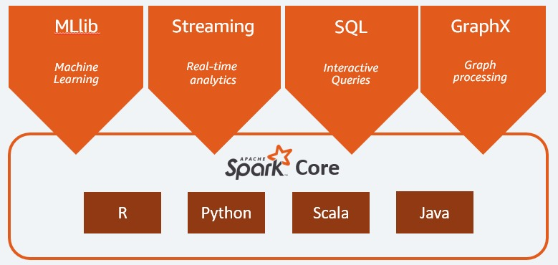
Introduction to Spark
Spark Ecosystem

Slide 9
Introduction to Spark
Spark's main feature is its processing speed.
For disk operations, it can be 10 times faster than Hadoop, and for in-memory operations it can be up to 100 times faster.
It can be used on its own or on platforms such as Hadoop, EC2, YARN and Mesos. It can also access data from Cassandra, Alluxio, HDFS, Hive and hundreds of other databases.
Apache Spark responds to a hierarchical master/slave architecture
The Spark driver is the master node that converts the user's code into various tasks that can be distributed among the worker nodes and delivers the results of the data.

Slide 10
Introduction to SparkSpark | Tema 2
Spark Core
It is the execution base for all parallel data processing. It provides fast in-memory computing and referencing of databases located in external storages. It is responsible for the following functions:
Memory management and fault recovery.
Planning, distribution and monitoring of tasks in a cluster.
Interaction with storage systems.
Data abstraction
Spark's core is also the functional foundation of libraries such as Spark SQL, Spark Streaming, ML, MLlib, and GraphX.

Slide 11
Introduction to Spark
RDD
Resilient Distributed Datasets or RDDs are a fundamental structure of Spark for Big Data.
It is a programming abstraction consisting of collections of items stored in fault-tolerant memory that can be distributed among multiple nodes of a cluster and processor in parallel, and then put back together on the core node. This allows its processing to be fast and scalable.

Slide 12
Introduction to Spark
Spark SQL
The most widely used interface by Spark developers to create applications.
It focuses on processing of structured data.
But at the same time, it allows queries on unstructured data
It allow corporations to reused their carefully developed SQL queries to port them into big data, which saves a lot of time and cost.

Slide 13
Introduction to Spark
Spark Streaming
It allows to process scalable and fault-tolerant data flows in near real time. Data can be digested from Kafka, Flume, and HDFS which is Hadoop Distributed File System
Data can be processed using complex algorithms and sent to file systems, databases and real-time dashboards

Slide 14
Introduction to Spark
ML/MLIB
Libraries of algorithms to perform operations focused on Machine Learning
MLIB is for processing RDDs
ML is for processing Spark Dataframes
Spark is equipped with a large collection of classification, regression, clustering and collaborative filtering algorithms.
ML in Python, is similar to the well-known Scikit-Learn
It also includes tools to create, evaluate and adjust machine learning pipelines, that is, build a process or workflow that can be exported to other platforms and made available in a Web service (URL)

Slide 15
Introduction to Spark
GraphX
In addition to offering several operations for graph manipulation, it provides some graph algorithms such as PageRank. GraphX unifies the ETL (Extract, Transform and Load) process, exploratory analysis, and iterative computations within the same system.

Slide 16
Introduction to Spark
Apache Spark can work on a single network node or on multiple nodes, that is, in a private cluster, since it only needs the installed Spark software and a java virtual machine or JVM
However, to achieve more robust performance and more efficient use of the worker nodes in the cluster, it is normal to run Spark with Hadoop Yarn, which is a resource manager (Yet Another Resource Manager)
This is how Cloudera and Horton create their distributions
Apache Spark can also run with Apache Mesos, and the Kunernets and Docker Swarm virtualization and distribution systems.
Spark, designed primarily for data science, is considered to be the largest open source project for data processing.

Slide 17
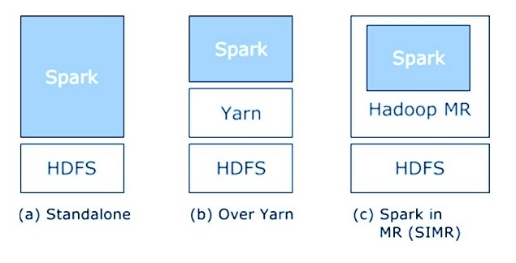
Introduction to Spark
Building Spark with Hadoop components

Slide 18
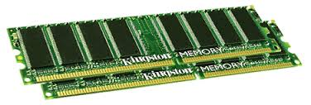
Spark Uses Memory instead of Disk
Hadoop: Use Disk for Data Sharing
HDFS
read
HDFS
Write
HDFS
read
HDFS
Write
Iteration1
Iteration2
Spark: In-Memory Data Sharing
HDFS read
Iteration1
Iteration2

Slide 19
Sort competition
 | Hadoop MR Record (2013) | Spark Record (2014)
Data Size | 102.5 TB | 100 TB
Elapsed Time | 72 mins | 23 mins
# Nodes | 2100 | 206
# Cores | 50400 physical | 6592 virtualized
Cluster disk throughput | 3150 GB/s (est.) | 618 GB/s
Network | dedicated data center, 10Gbps | virtualized (EC2) 10Gbps network
Sort rate | 1.42 TB/min | 4.27 TB/min
Sort rate/node | 0.67 GB/min | 20.7 GB/min
Spark, 3x faster with 1/10 the nodes
Sort benchmark, Daytona Gray: sort of 100 TB of data (1 trillion records)
http://databricks.com/blog/2014/11/05/spark-officially-sets-a-new-record-in-large-scale-sorting.html

Slide 20
Apache Spark
Apache Spark supports data analysis, machine learning, graphs, streaming data, etc. It can read/write from a range of data types and allows development in multiple languages.
Scala, Java, Python, R, SQL
DataFrames
ML Pipelines
Spark SQL
Spark Streaming
MLlib
GraphX
Spark Core
Data Sources
Hadoop HDFS, HBase, Hive, Apache S3, Streaming, JSON, MySQL, and HPC-style (GlusterFS, Lustre)

Slide 21
Resilient Distributed Datasets (RDDs)
RDDs (Resilient Distributed Datasets) is Data Containers
All the different processing components in Spark share the same abstraction called RDD
As applications share the RDD abstraction, you can mix different kind of transformations to create new RDDs
Created by parallelizing a collection or reading a file
Fault tolerant

Slide 22
DataFrames & SparkSQL
DataFrames (DFs) is one of the other distributed datasets organized in named columns
Similar to a relational database, Python Pandas Dataframe or R’s DataTables
Immutable once constructed
Track lineage
Enable distributed computations
How to construct Dataframes
Read from file(s)
Transforming an existing DFs(Spark or Pandas)
Parallelizing a python collection list
Apply transformations and actions

Slide 23
DataFrame example
// Create a new DataFrame that contains “students”
students = users.filter(users.age < 21)
//Alternatively, using Pandas-like syntax
students = users[users.age < 21]
//Count the number of students users by gender
students.groupBy("gender").count()
// Join young students with another DataFrame called logs
students.join(logs, logs.userId == users.userId,
“left_outer")

Slide 24
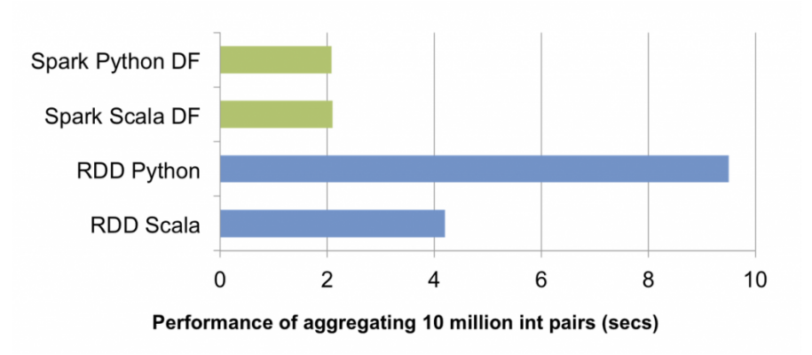
RDDs vs. DataFrames
RDDs provide a low level interface into Spark
DataFrames have a schema
DataFrames are cached and optimized by Spark
DataFrames are built on top of the RDDs and the core Spark API
Example: performance

Slide 25
Spark Operations
Transformations (create a new RDD) | map filter sample groupByKey reduceByKey sortByKey intersection | flatMap union join cogroup cross mapValues reduceByKey
Actions (return results to driver program) | collect first Reduce take Count takeOrdered takeSample countByKey take save lookupKey foreach

Slide 26
Python RDD API Examples
Word count
text_file = sc.textFile("hdfs://usr/godil/text/book.txt")
counts = text_file.flatMap(lambda line: line.split(" ")) \
.map(lambda word: (word, 1)) \
.reduceByKey(lambda a, b: a + b)
counts.saveAsTextFile("hdfs://usr/godil/output/wordCount.txt")
Logistic Regression
# Every record of this DataFrame contains the label and
# features represented by a vector.
df = sqlContext.createDataFrame(data, ["label", "features"])
# Set parameters for the algorithm.
# Here, we limit the number of iterations to 10.
lr = LogisticRegression(maxIter=10)
# Fit the model to the data.
model = lr.fit(df)
# Given a dataset, predict each point's label, and show the results.
model.transform(df).show()
Examples from http://spark.apache.org/

Slide 27
RDD Persistence and Removal
RDD Persistence
RDD.persist()
Storage level:
MEMORY_ONLY, MEMORY_AND_DISK, MEMORY_ONLY_SER, DISK_ONLY,…….
RDD Removal
RDD.unpersist()

Slide 28
Broadcast Variables and Accumulators (Shared Variables )
Broadcast variables allow the programmer to keep a read-only variable cached on each node, rather than sending a copy of it with tasks
>broadcastV1 = sc.broadcast([1, 2, 3,4,5,6])
>broadcastV1.value
[1,2,3,4,5,6]
Accumulators are variables that are only “added” to through an associative operation and can be efficiently supported in parallel
accum = sc.accumulator(0)
accum.add(x)
accum.value

Slide 29

Reflection
Now that you know a little more about Spark, do you think that learning to use big data technologies like Spark opens doors in your professional career?
Do you think big data technologies can help solve the challenges organizations fac? What challenge would you choose? How would you apply big data technologies in this challenge?

Slide 30

Integration
The main set of tools for leveraging big data is the Spark ecosystem. Spark is fast, scalable, and resilient. Spark is a set of tools that allows mining, transformation, manipulation, search for static and dynamic information.
It is possible to contract integrated and managed Spark solutions at a reasonable cost using the cloud services of leading technology solutions companies.

Slide 31
Key Idea
Spark is currently, the most widely used Big Data ecosystem

